Slide 1

READ PRIOR TO PRESENTATION
Print the presentation (or selected modules) in NOTES LAYOUT format (If you are using a 2 monitor screen, the presentation will automatically default to a “presenter” format.
Read the presentational notes (this presentation is interactive)
This presentation has embedded videos
  To play videos:
    Hover over the footer until the PLAYER displays
    CLICK the PLAY button
    When video is complete, make sure the mouse is not on the player bar, then CLICK ENTER or an ARROW KEY to move to the next slide
Your desktop monitor displaying the presentation notes, and next slide view.
The presentation screen displaying the presentation view for the audience.

Slide 2
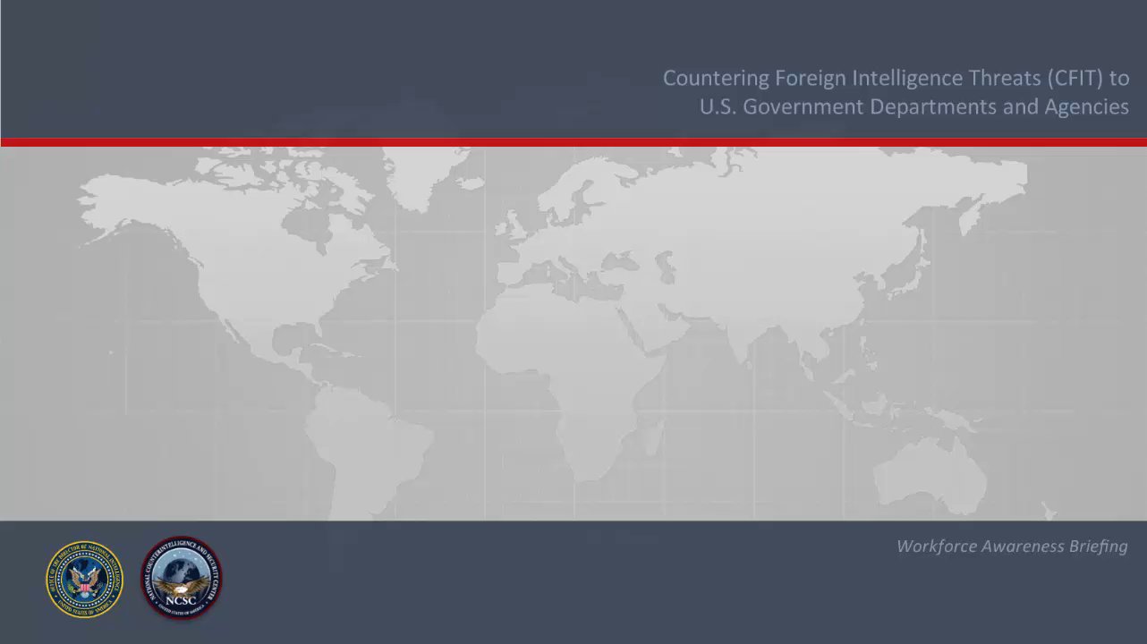

Slide 3
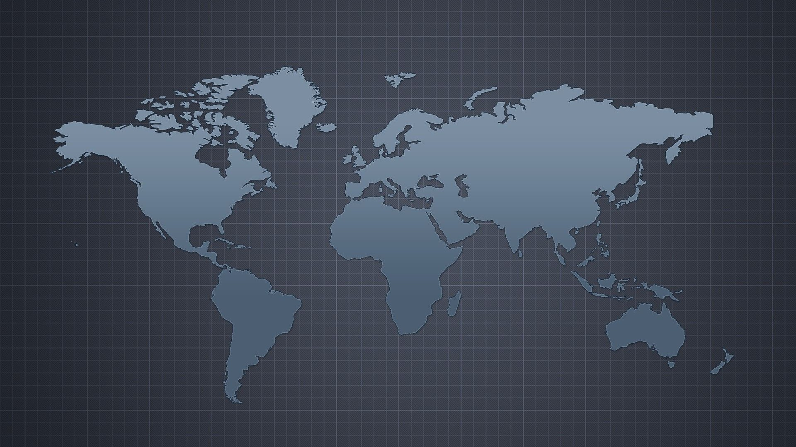


Countering Foreign Intelligence Threats (CFIT) to
U.S. Government Departments and Agencies
How does this
apply to me?
3
What are foreign intelligence threats?
1
What do they want?
2
Workforce Awareness Briefing
Notes:
Overview-
PRESENTER:
“For decades, the mission of “counterintelligence” was confined to those who worked within the Intelligence Community or otherwise had access to classified information. It generally involved our intelligence agencies squaring off against the intelligence agencies or our traditional foes across the globe.
Our foreign adversaries and competitors are no longer seeking just classified information. They are targeting any sensitive information, infrastructure, technology, or other resources that would weaken our economic and national security and strengthen their own. Therefore, the responsibility to counter foreign intelligence threats is one shared across the executive branch, private industry, or any other organization with access to such sensitive and proprietary information and resources.
This briefing explains the basis of the foreign intelligence threat’s, the information and resources vulnerable to these threats, and how departments and agencies, and most importantly you, can counter those threats and safeguard the mission of your organization.”
************************************************************************************************************************************************************************************************
PRESENTER- CLICK TO DISPLAY THE FOLLOWING 3 QUESTIONS
“There are 3 questions we need to ask ourselves-
(click) 1- What are foreign intelligence threats?
These are threats posed by foreign adversaries (political and military) and competitors (economic) to information and resources considered vital to our national and economic security, global U.S. competitiveness, and the mission of individual departments and agencies. The actions could be a foreign intelligence service, but they could also be a foreign aerospace company, pharmaceutical conglomerate, information technology center and transnational criminal organizations and terrorist groups.
(click) 2- What do they want?
In general, our foreign adversaries and competitors are actively seeking sensitive or proprietary financial, trade, or economic policy information; pioneering research and development; emerging technologies; and information related to critical infrastructure sectors, including energy, financial services, information technology, communications, food/agriculture and healthcare.
(click) 3- How does this apply to me?
As a government employee or contractor, you have connections and access to the information and resources they are seeking to acquire or steal. No matter how high or low you rank within your organization, you are likely viewed as an asset to be approached, in person or online, and developed.”

Slide 4

TARGETING & RECRUITMENT
Notes:
TRANSITION SLIDE:
PRESENTER: “How many of you have ever attended a work conference, or trade show, either domestically or overseas? Ever met someone new there, exchanged business cards and email addresses? Perhaps connected with them on LinkedIn or Facebook?
How about someone who worked for a foreign company, or even a foreign government?
Let’s meet Peter, and then ask yourself, could this happen to me?”

Slide 5
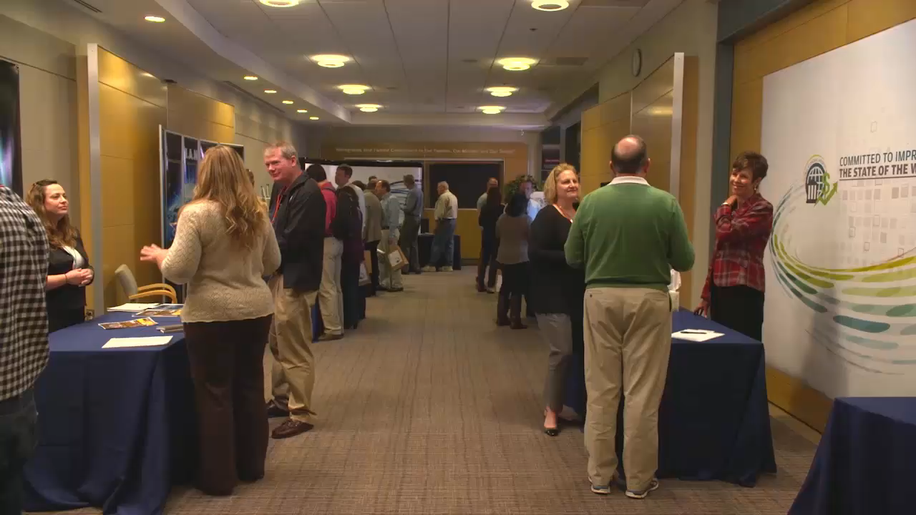
TARGETING & RECRUITMENT VIDEO
Notes:
PRESENTER: HOVER OVER THE BOTTOM FRAME. CLICK THE PLAY BUTTON TO VIEW MOVIE.
CLICK THE ENTER KEY TO GO TO NEXT SLIDE

Slide 6
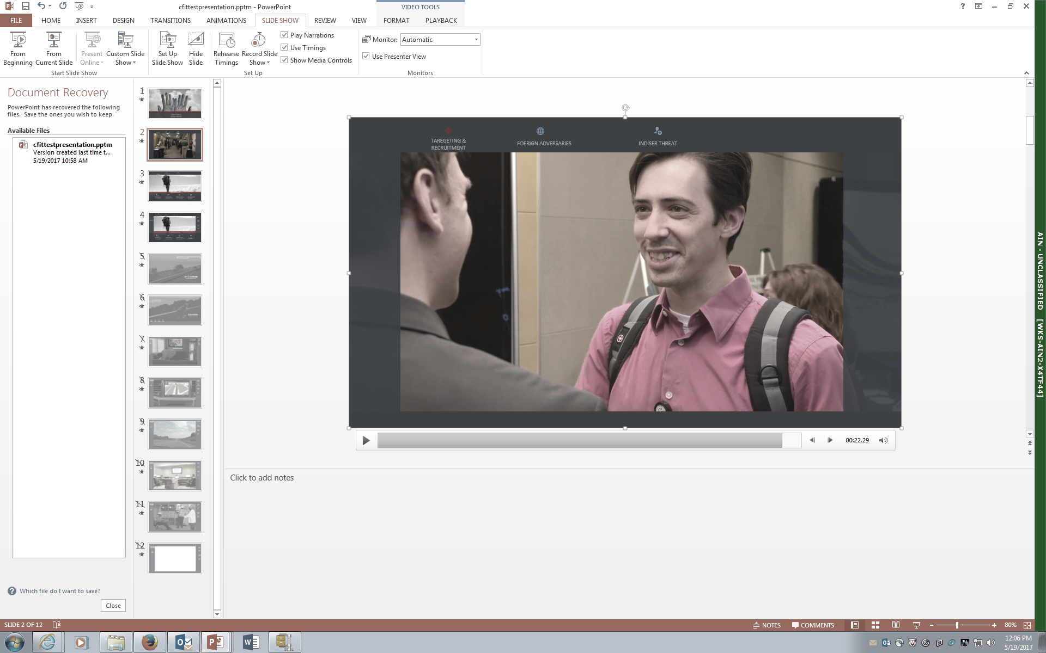
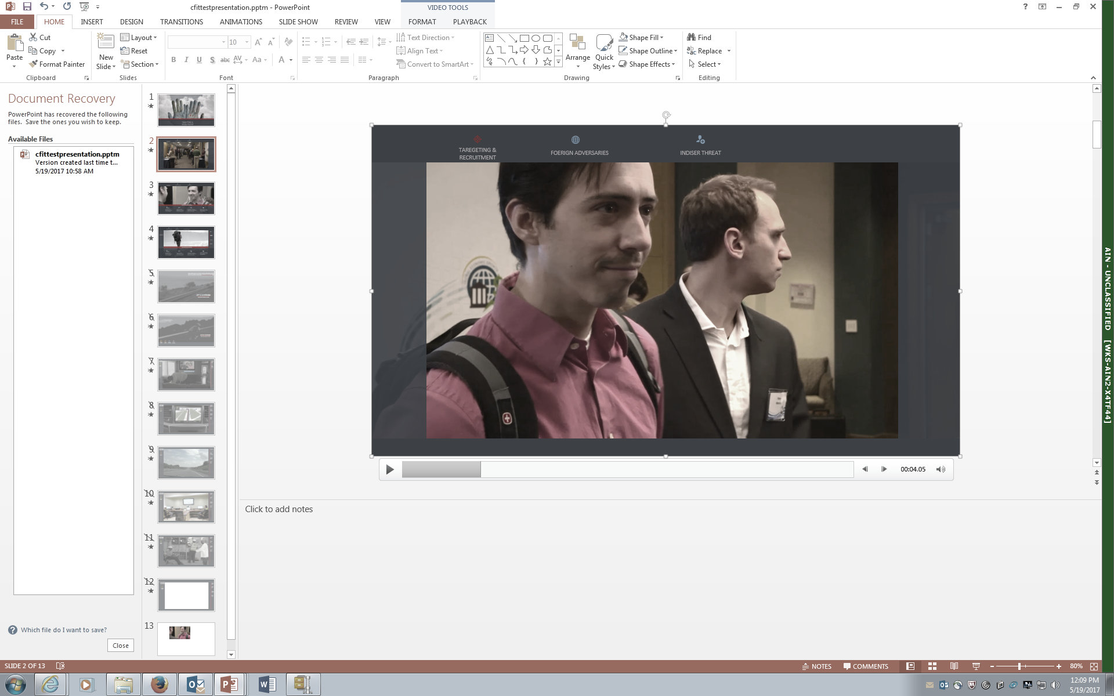
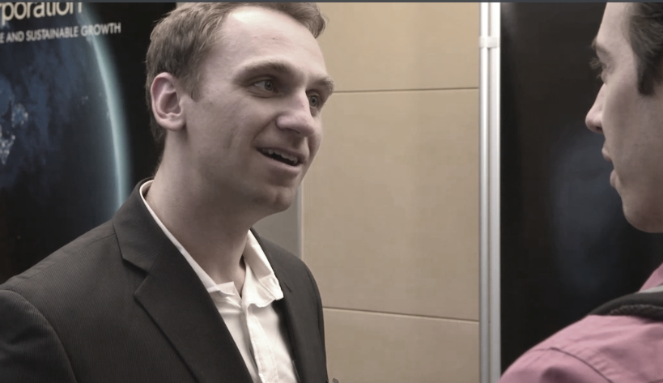

ELICITATION
The use of a conversation to extract information:
person
phone
email
social media
Things to Remember
1
2
3
4
If you suspect you’ve been targeted, report it immediately
No matter your level of access, you may be targeted
Targets are often approached in a non-threatening manner
Tradeshows, business conferences, social events and social media are all points of interest
Notes:
PRESENTER:
READ THE “THINGS TO REMEMBER” BULLETS, then AUGMENT WITH THE FOLLOWING:
Bullet point 1-
“Our foreign adversaries and competitors will target everyone in an organization from the executive director to an executive assistant, the cleaning staff, or even logistics personnel. Sometimes the potential for future access or the ability of the targeted individual to lead to other high value targets is enough to generate interest.”
Bullet point 2-
“Once an individual has been targeted, a relationship is cultivated with the target. They might appeal to ideological leanings or financial gain or simply resort to blackmail or coercion. Or the cultivation can be less direct, such as with the use of social engineering, which includes personal elicitation of information, phishing campaigns, and other such methods to gather information from an unwitting source.”
(CLICK mouse one time. Definition will appear. Talk about Elicitation)
Definition of “elicitation” – The use of conversation to extract information, either in person, by email, on the phone, or through social media. A trained intelligence officer is a master of elicitation, and luring people into divulging important information, often unwittingly.”
Bullet point 3-
“These Tradeshows, conferences, and various social forums, all present opportunities for trained agents to elicit information from an unsuspecting target.”
Bullet point 4-
“Your personal information can be used to gain your trust or begin and develop a relationship. So the more personal information you post on social media, and leave unprotected, the more vulnerable you become. Maximize your privacy settings, so you’re only sharing such information with those you know and trust.”
Here at _________, any suspicious contact should be reported to ______.”

Slide 7
ANSWERS
A
A. No matter your level of access, you may be targeted
C
B. If you suspect you’ve been targeted, report it immediately
D
C. Targets are often approached in a non-threatening manner
B
D. Tradeshows, business conferences, social events and social media are all points of interest
Things to Remember
SUMMARY
TAREGETING & RECURITING
Notes:
PRESENTER:
NOTE- This is an interactive, fun, summary/recap of the module, based on the “Things to Remember” slide. See if the audience can match the correct icon and statement. CLICK the mouse to reveal each answer.

Slide 8
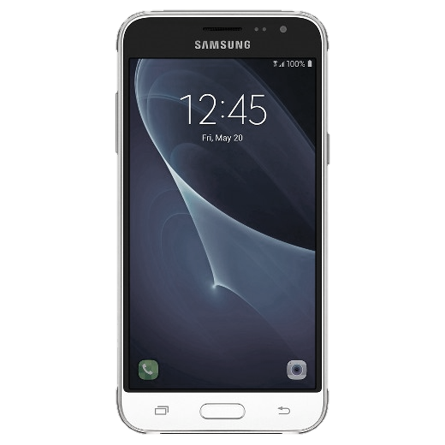









CFIT
BE AWARE
ELICITATION
THUMB DRIVES
COMMUNICATIONS
SURVEILLANCE
REPORT
INCIDENTS IMMEDIATELY
FOREIGN TRAVEL
Notes:
TRANSITION SLIDE:
PRESENTER: “International travel has become an essential part of our government, business, and, for some, personal lives. But travel can be challenging, especially when visiting those countries with an unstable government, embroiled with religious and ethnic conflicts, or affected by organized crime or street criminals. But friendly countries pose risks as well. As a government employee, or contractor, it is important to understand the risk to your personal safety when traveling abroad, and that you may be targeted by foreign adversaries and competitors because of who you work for and what you do. When overseas, they have greater access to you, and their actions are far less restricted.
Let’s take a look at Frank. Frank is attending an international work conference, in a “friendly” country, and hopes to do some sightseeing while he’s there. Some of this may look familiar to you. Some of it may not.”

Slide 9
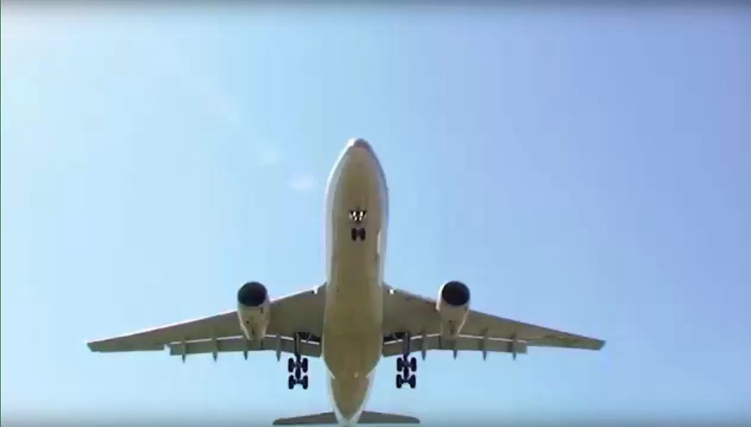
FOREIGN TRAVEL VIDEO
Notes:
PRESENTER: HOVER OVER THE BOTTOM FRAME. CLICK THE PLAY BUTTON TO VIEW MOVIE.
CLICK THE ARROW KEY OR HIT ENTER TO GO TO NEXT SLIDE

Slide 10
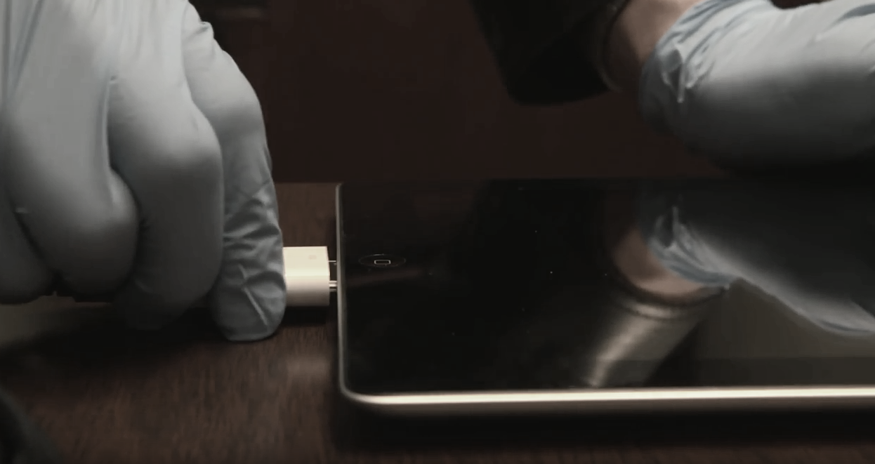
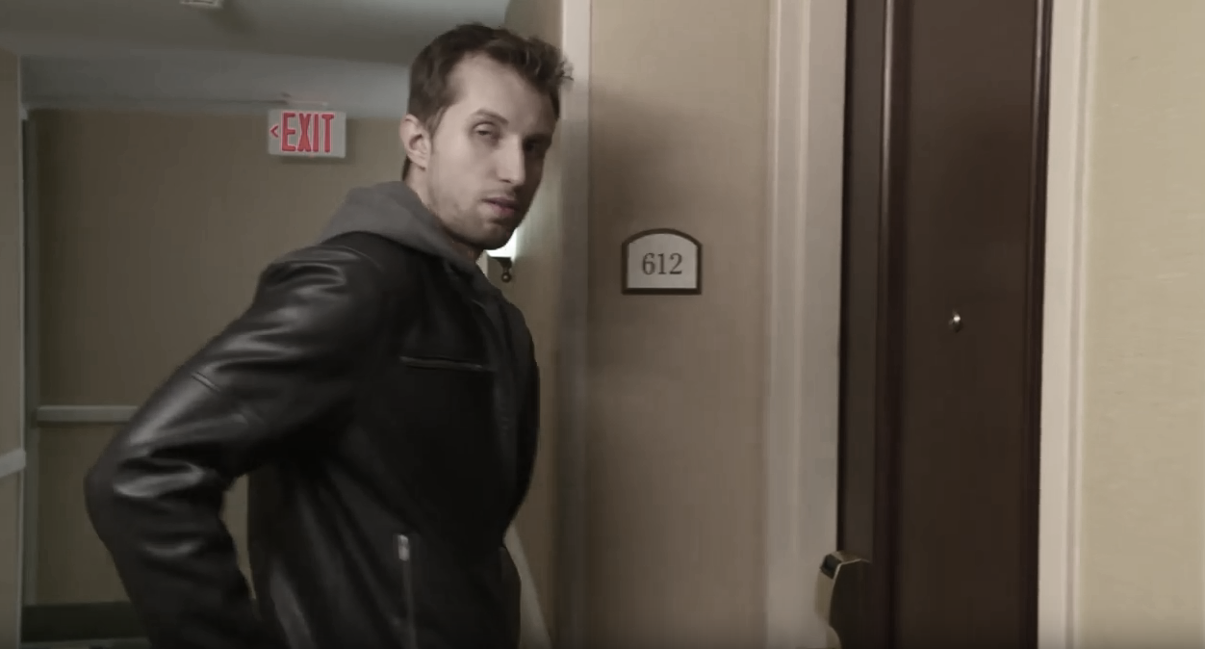
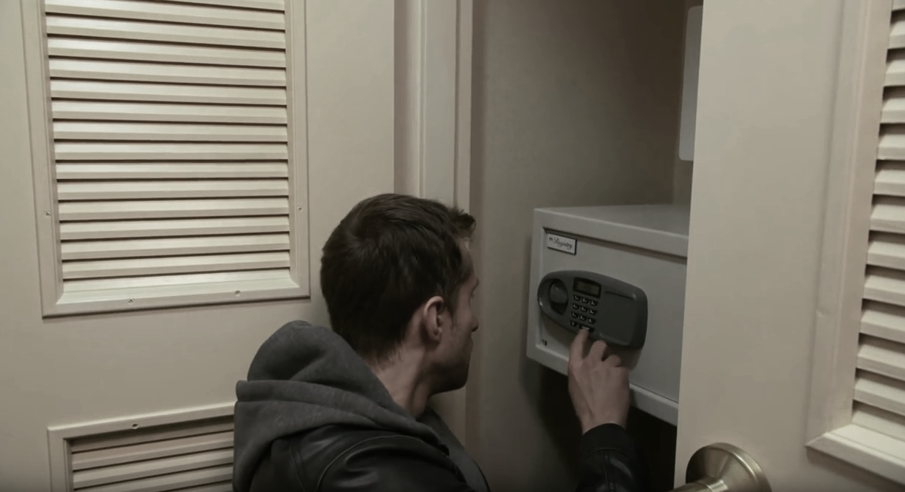
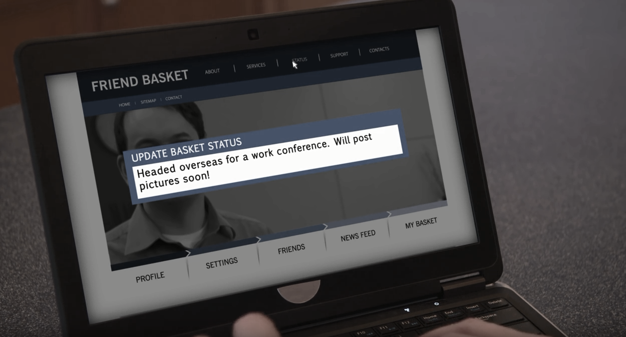
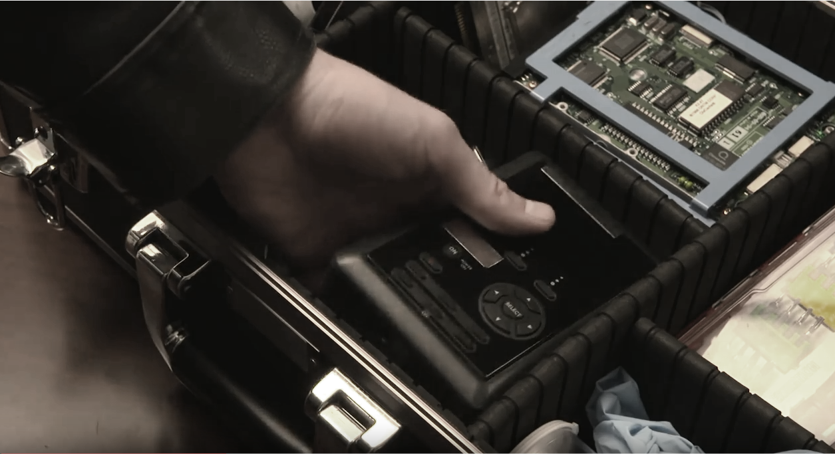
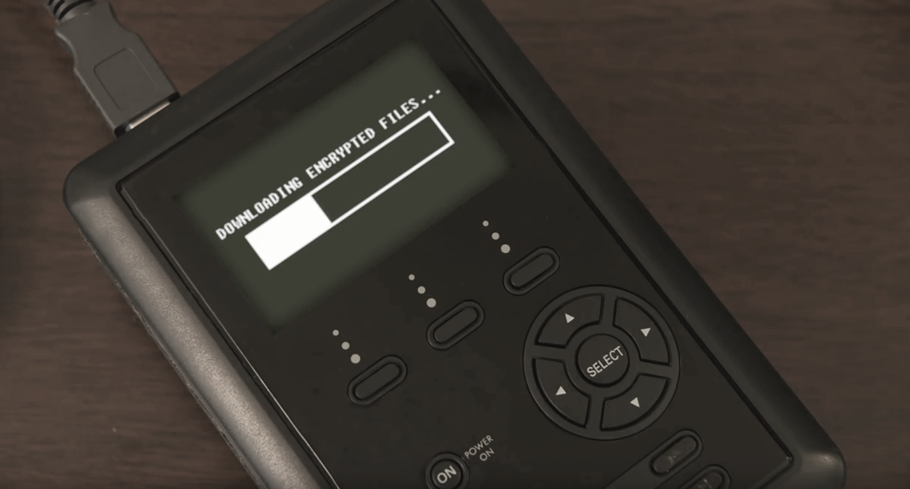
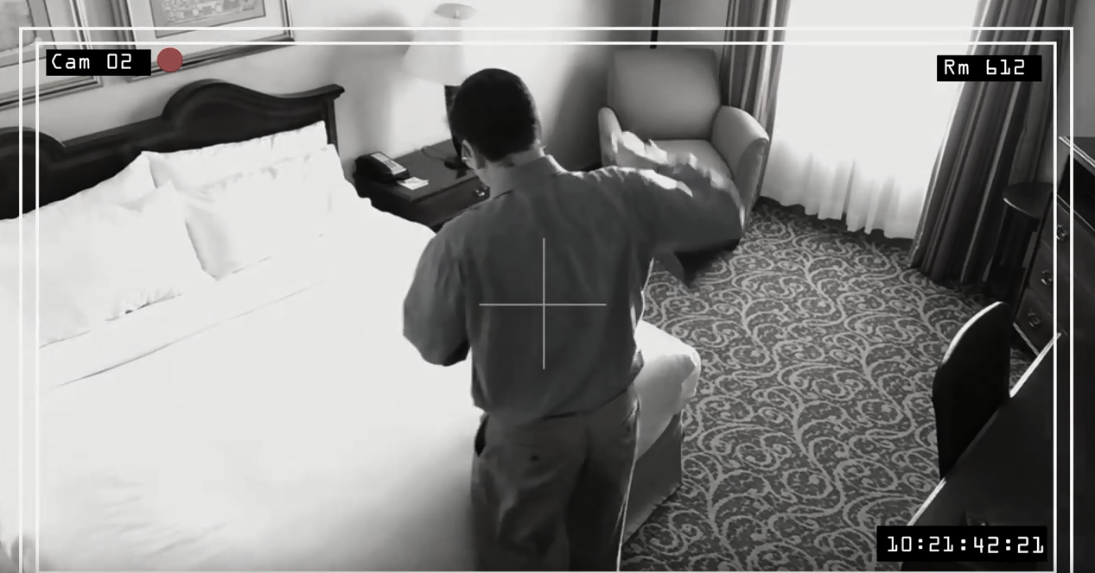

Things to Remember
1
2
3
4
Take care of basic housekeeping when you return
Government employees should understand the risks involved with overseas travel
Never assume privacy. A friendly country may not be so “friendly”
Smartphones, tablets and laptops are more susceptible than ever to security threats
Notes:
PRESENTER:
READ THE “THINGS TO REMEMBER” BULLETS, then AUGMENT WITH THE FOLLOWING:
Bullet point 1-
“Do not publicize travel plans before or during your trip, beyond those family and friends you know and trust. Limit the sharing of detailed information to only those who need to know. Regularly check your privacy settings on social networking sites. Maintain control of any sensitive or proprietary material or electronic devices, do not leave them unattended in a hotel room or anywhere else, and remember that a hotel room safe isn’t “safe.” Finally, whenever socializing with others overseas, don’t overshare personal information with new acquaintances.”
Bullet point 2-
“Remember, even in friendly countries, you are at risk. Our foreign adversaries routinely operate in other countries. Also, just because our nation may be a political or military ally of another, we still likely have companies and research institutions within our two countries that are highly competitive with each other. Thus, when traveling, you should have no expectation of privacy, physical or electronic, and understand that everything you do, inside and outside your hotel room, may be monitored and recorded. You may also be targeted by persons around you- hotel staff, drivers, guides, and others may be working on behalf of an adversary or competitor.”
Bullet point 3-
“WiFi networks in foreign hotels and elsewhere overseas are unsecure and regularly monitored, and if you connect to them, malicious software can be easily uploaded to your mobile device. Even charging your device in an international airport poses significant risks. Leave unnecessary electronic devices at home. Perform a comprehensive anti-virus scan on all electronic devices prior to departure and upon return. Use complex passwords, and modify them when you return.”
Bullet point 4-
“If a mobile device or laptop was compromised while overseas, so are your passwords, so change them when you return. Monitor your financial accounts and beware of suspicious emails and new contacts. If you believe your personal information may have been compromised, contact the appropriate banks, credit card companies, and credit bureaus. If you believe any sensitive government information in your care may have been compromised, contact (insert your internal agency reporting processes)”

Slide 11
ANSWERS
D
A. Government employees should understand the risk involved with overseas travel
C
B. Never assume privacy. A friendly country, may not be so “friendly”
B
C. Smartphones, tablets and laptops are more susceptible than ever to security threats
A
D. Take care of basic housekeeping when you return
Things to Remember
SUMMARY
FOREIGN TRAVEL
Notes:
PRESENTER:
NOTE- This is an interactive, fun, summary/recap of the module, based on the “Things to Remember” slide. See if the audience can match the correct icon and statement. CLICK the mouse to reveal each answer.

Slide 12
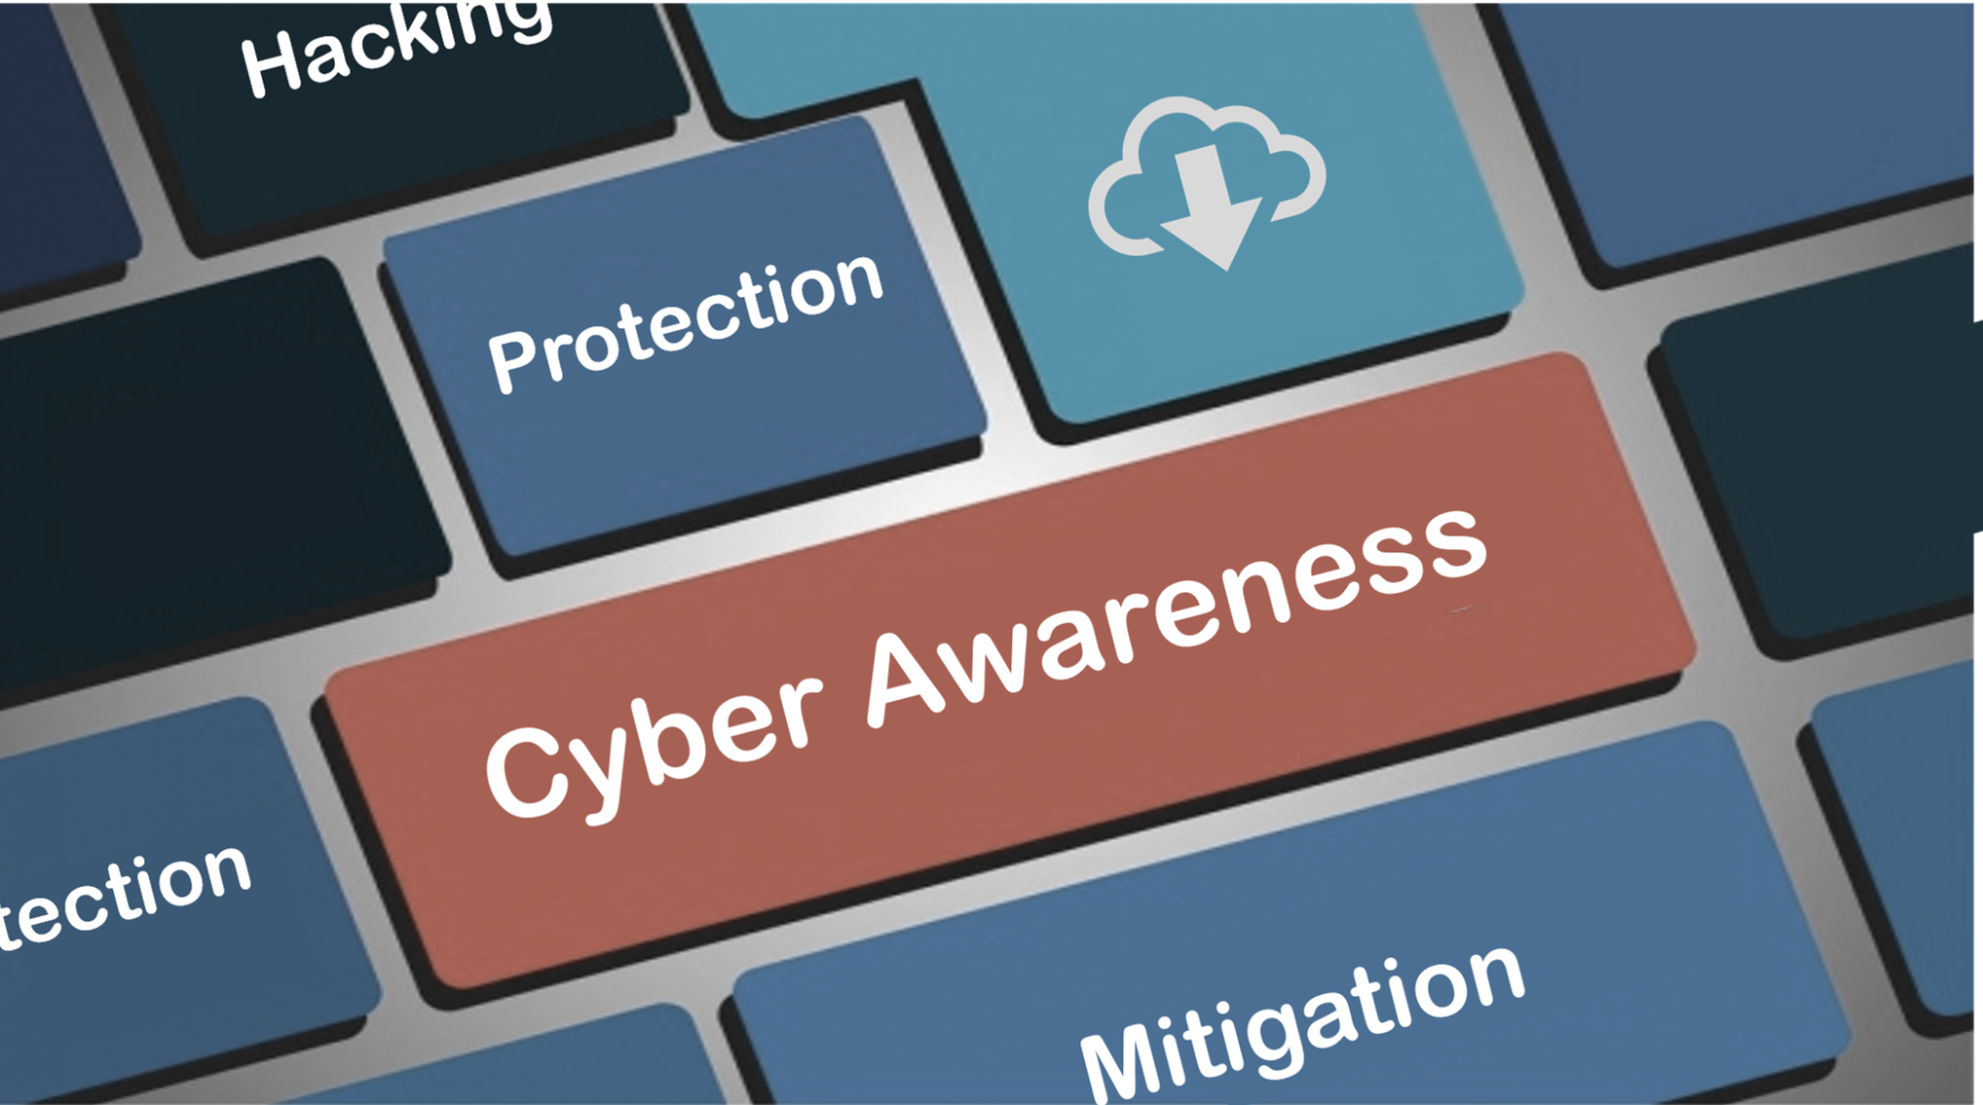
CYBER AWARENESS
Notes:
TRANSITION SLIDE:
PRESENTER: “Technology is a catalyst for the rapid emergence of new threats, threats we must anticipate and defeat to keep our information networks secure. Simply put, if our information networks are compromised by foreign intelligence threats, the loss of sensitive information, research, and other data could be catastrophic for our national and economic security.
Our adversaries and competitors will employ varied tactics to gain access to these information networks – every single one of them can be defeated by vigilant employees. These tactics include spear phishing, where employees are sent emails with malicious links or attachments, and spoofing emails that imitate valid domains (i.e. .mil .gov, or .edu addresses). Websites and other platforms with unpatched or outdated software can be highly vulnerable to such attacks.”

Slide 13

CYBER AWARENESS VIDEO
Notes:
PRESENTER: HOVER OVER THE BOTTOM FRAME. CLICK THE PLAY BUTTON TO VIEW MOVIE.
CLICK THE ENTER KEY OR ENTER TO GO TO NEXT SLIDE

Slide 14
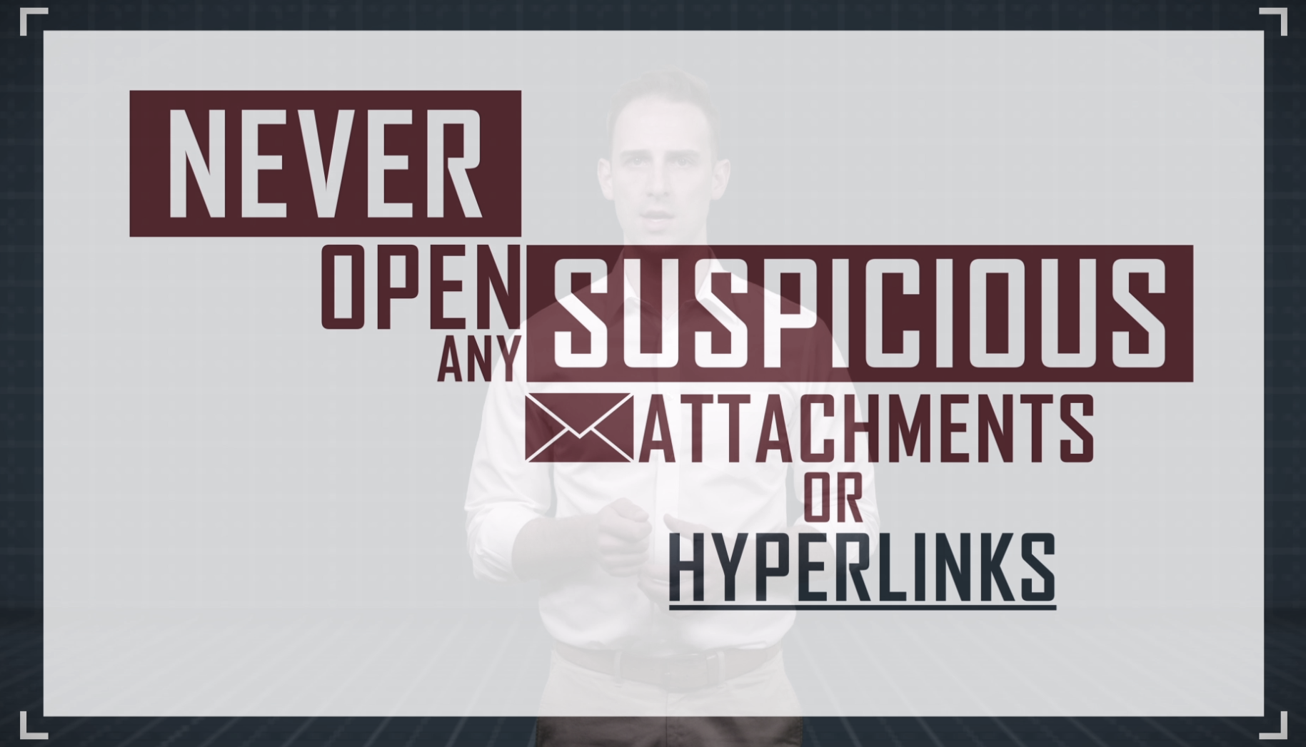
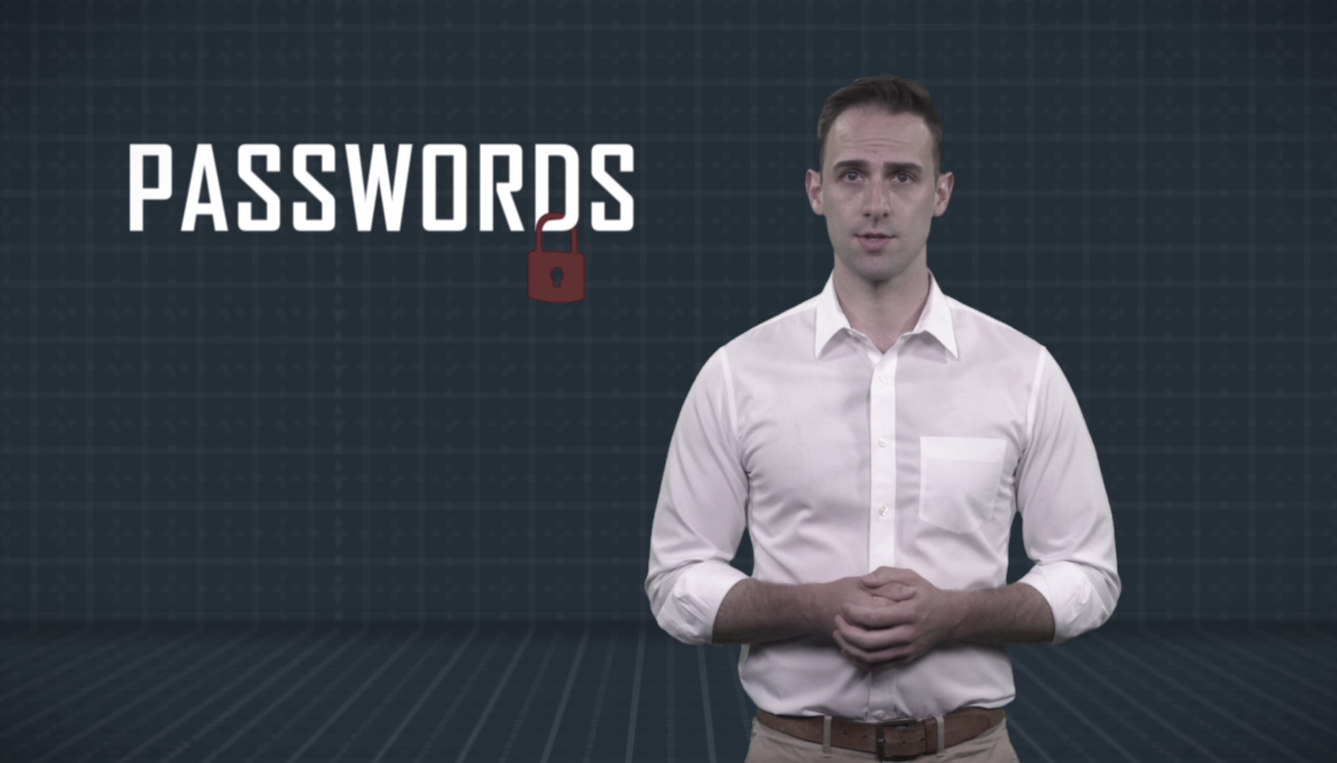
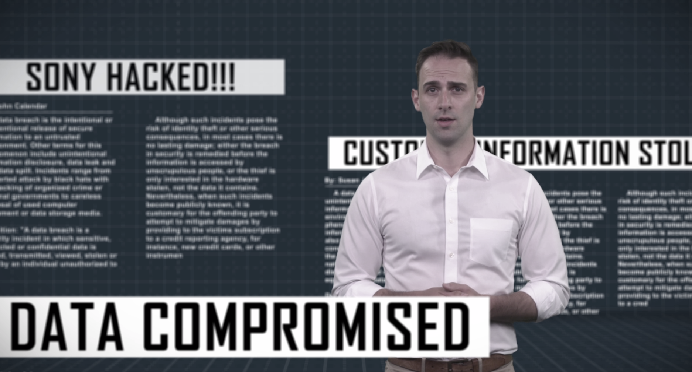
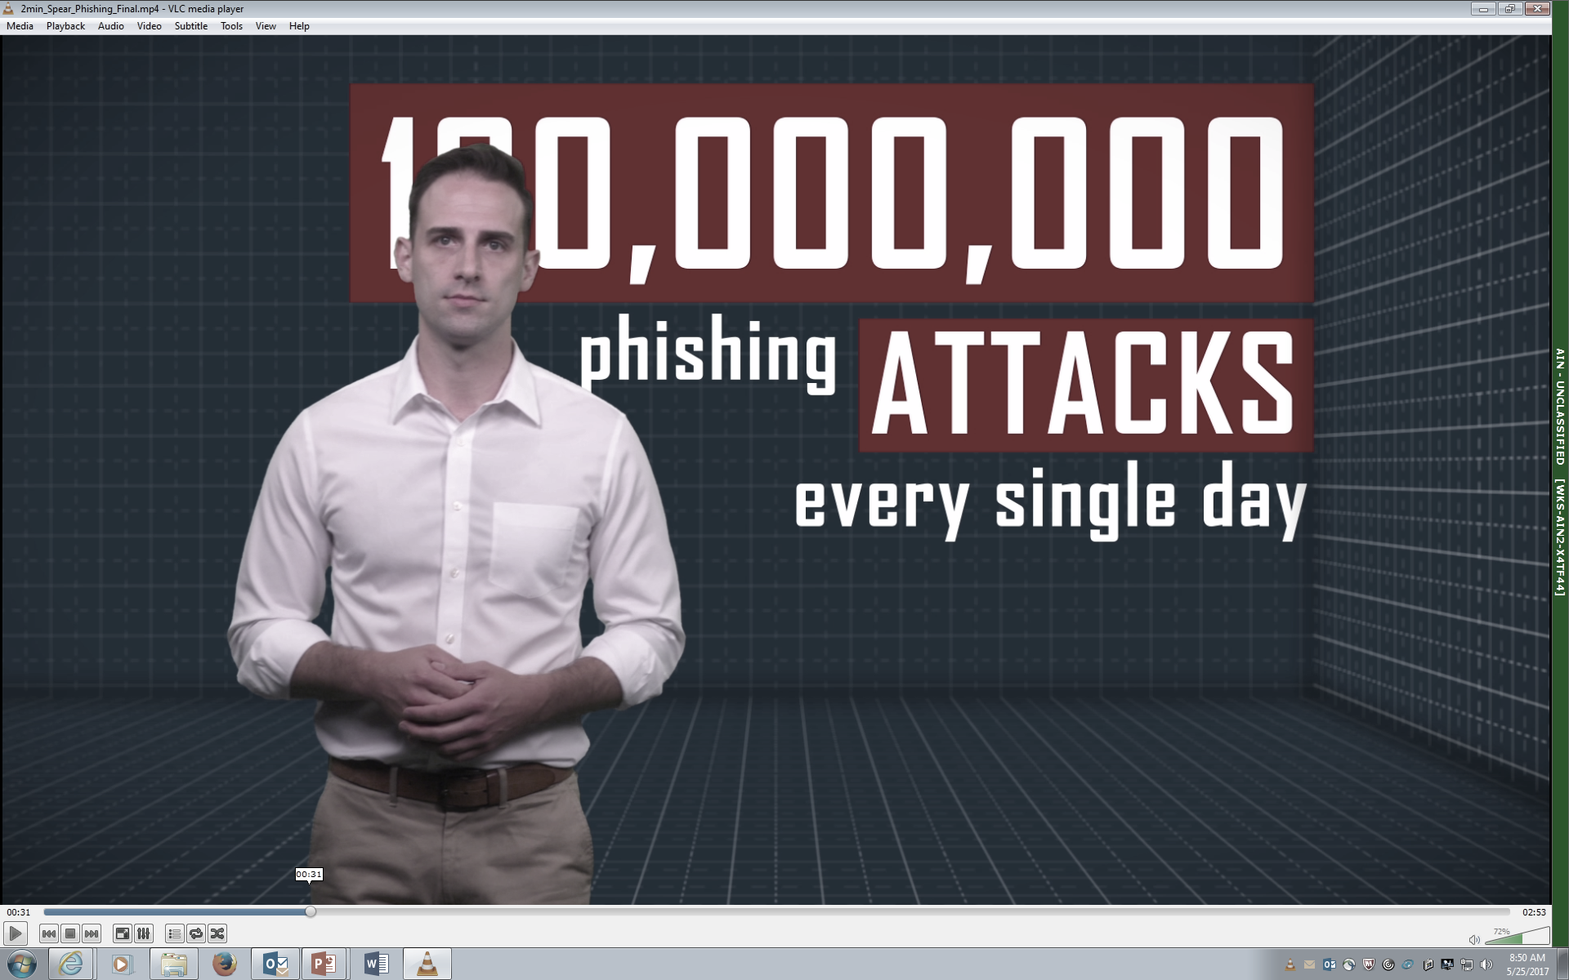

SUSPICIOUS
Cyber incidents that should be reported:
System or website’s availability has been disrupted
Attempts to gain information regarding the cyber security posture of your network, software or hardware
Unauthorized changes made to a system’s hardware, firmware or software
Receipt of emails that include unsolicited attachments, or unusual requests for sensitive information
Things to Remember
1
2
3
4
Report all suspicious or unusual problems
A strong password is imperative
Do not open emails or attachments from unfamiliar sources
Practice “Cyber Smarts”
Notes:
READ THE “THINGS TO REMEMBER” BULLETS, then AUGMENT WITH THE FOLLOWING:
Bullet point 1-
“The ideal password is a combination of random numbers, symbols, and upper and lower case letters. Follow National Institute of Standards and Technology (NIST) guidelines for secure passwords.”
Bullet point 2-
“Even if the sender looks familiar, spear phishing is a low-tech and inexpensive but highly effective technique used by adversaries, hackers, and others to infect your computer or mobile device with malicious software and other viruses. Never click on or open suspicious links or attachments.”
Bullet point 3-
“Keep your software updated, research the apps you download and use, protect your personal information through encryption, and use only secure connections.”
PRESENTER: (Click to display the following. Read these prior to bullet 4)
“Suspicious cyber incidents that should be reported:
Your system or website’s availability has been disrupted, or service has been denied to system users
Someone attempts to gain information in person, by phone, mail, email, regarding the configuration and/or cyber security posture of your website, network, software, or hardware.
Someone attempts to gain unauthorized access to your system or the data stored in the system
Unauthorized changes or additions have been made to a system’s hardware, firmware, or software characteristics without the IT department’s knowledge or consent
Employees in the organization are receiving emails that include unsolicited attachments and/or requests for sensitive information”
Bullet point 4-
Here at _________, any suspicious contact should be reported to ______.”

Slide 15
ANSWERS
A
A. A strong password is imperative
B
B. Do not open emails or attachments from unfamiliar sources
C
C. Practice “Cyber Smarts”
D
D. Report all suspicious or unusual problems
Things to Remember
SUMMARY
CYBER AWARENESS
Notes:
PRESENTER:
NOTE- This is an interactive, fun, summary/recap of the module, based on the “Things to Remember” slide. See if the audience can match the correct icon and statement. CLICK the mouse to reveal each answer.

Slide 16

INSIDER THREAT VIDEO
Notes:
Play the video first, then get into the discussion of Insider Threat.
PRESENTER: HOVER OVER THE BOTTOM FRAME. CLICK THE PLAY BUTTON TO VIEW MOVIE.
CLICK THE ENTER KEY TO GO TO NEXT SLIDE

Slide 17
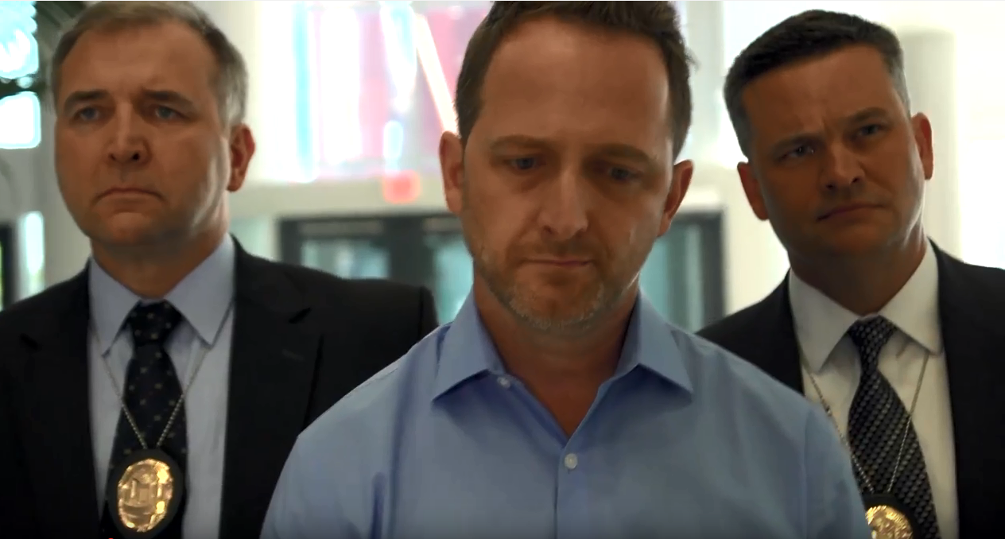
INSIDER THREAT
Notes:
TRANSITION SLIDE:
PRESENTER: You’ve probably heard the term ‘insider threat” a lot lately, but what exactly is an “Insider?”
An insider is any person with authorized access to government or contractor resources, including personnel, facilities, information networks, and information systems. “Insiders” may have access to classified information, sensitive or controlled unclassified information, and even proprietary corporate information, and could do significant harm to our national security and economic well-being if they were to act on behalf of or in concert with our foreign adversaries and competitors. Each of you has the ability to possibly deter a colleague from that path, if you are familiar with and can recognize the behavior of a potential malicious insider and know who to talk to about it.
Insiders with authorized access to an organization’s assets may use that access, either maliciously or unintentionally, in a way that could negatively affect the mission of the organization, compromise sensitive information or resources, put co-workers and colleagues at risk, and undermine our security and competitiveness.
Early detection of individuals with potentially malicious, careless, or risky behavior is vitally important to protecting sensitive information and resources from insider threats. Too often, we miss opportunities to intervene and either prevent or mitigate potential damage. In many cases of espionage and workplace violence, co-workers disclosed that they had noticed unusual behavior or questionable activities in the past but failed to report incidents because they did not recognize the pattern or were uncomfortable getting involved. Some thought they might cause problems for or negatively affect the standing and continued employment of their co-workers.
Failing to identify and report unusual behavior or questionable activities leaves an organization highly vulnerable to insider threats, jeopardizing our national and economic security, and, possibly, our physical safety. Not all suspicious circumstances or unusual behavior are indicators of insider threats, but every situation should be reported and closely reviewed by the appropriate authorities to determine potential risk to an organization and the information and resources it is responsible for safeguarding.”

Slide 18
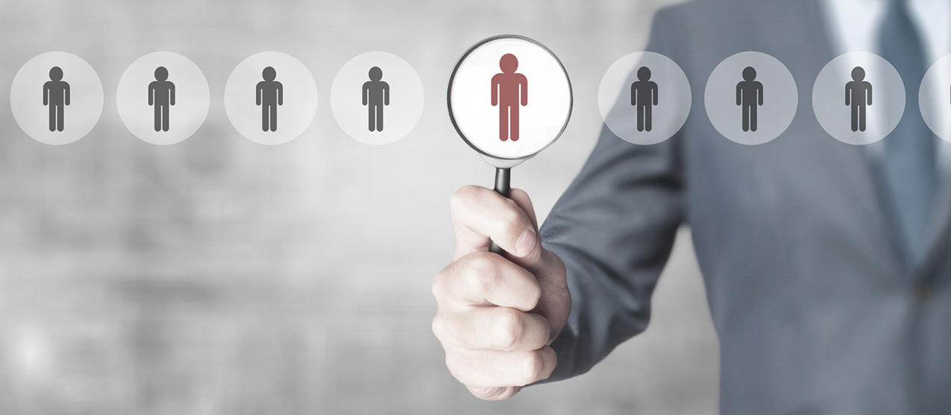

MOTIVES
GREED
VULNERABILITY
ANGER
IDEOLOGY
DIVIDED LOYALTY
Things to Remember
Behavioral indicators include…
1
2
3
4
Theft of information
Meeting with foreign contacts
Unexplained affluence
Changes in work/ attitude
Notes:
PRESENTER: (Click to display the following)
“Insiders may have different motivations, but the indicators are generally consistent. Motives or personal situations that may drive an insider threat include-
Greed or financial need, often as a result of excessive debt or overwhelming expenses
Vulnerability to blackmail or coercion, including extra-marital affairs, alcohol and drug use, gambling, and fraud
Anger or revenge, including disgruntlement to the point of wanting to cause harm to an organization the or colleagues
Ideology and the desire to advance a particular cause
Divided loyalty, including allegiance to another organization or country
So, how to you identify a potential insider threat? Some indicators include…”
PRESENTER: (Click to display the following)
“THINGS TO REMEMBER” BULLETS, then AUGMENT WITH THE FOLLOWING:
Bullet point 1-
“Without need or authorization, an individual removes sensitive information from the office, hard copies or by thumb drive or computer disk or by email. To obtain such information, they might also seek to expand their access beyond the requirements of their position.”
Bullet point 2-
“An employee schedules unusual meetings with foreign government officials, competitors, or other individuals without reporting such contacts.”
Bullet point 3-
“ An employee purchases homes, cars, jewelry, technology, or other lavish items they likely cannot afford on their household income.”
Bullet point 4-
“Changes such as: Excessive lateness, changes in attitude, or any other unusual behavior.”

Slide 19
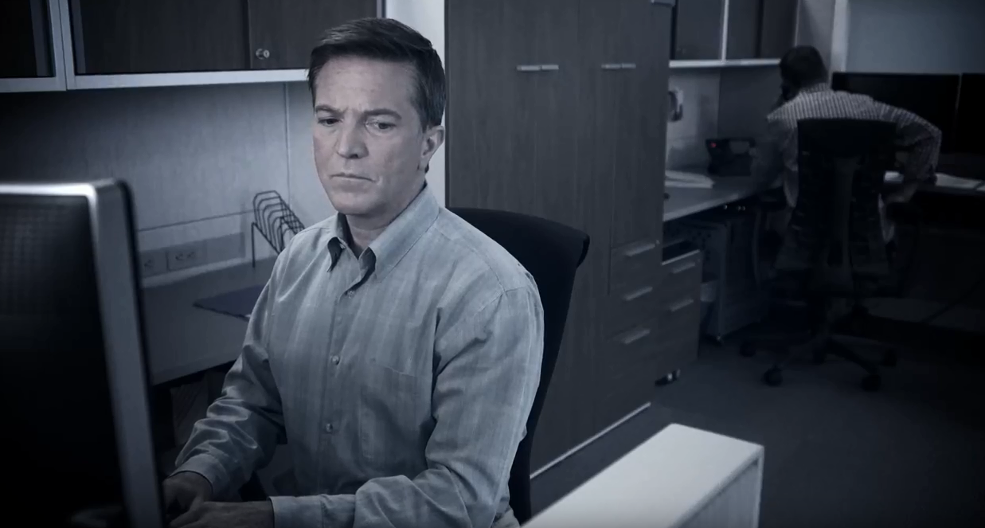
Be aware of the actions of those around you
Report any suspicious behavior
What can you do to help?
Notes:
TRANSITION SLIDE:
PRESENTER: After you read the bullets on the screen, then conclude with the following:
“Remember, you have a responsibility both to your organization and the colleagues you work with.
“Report any suspicious behavior to your Insider Threat Program or appropriate CI/Security elements.”

Slide 20
ANSWERS
C
A. Meeting with foreign contacts
A
B. Unexplained affluence
B
C. Theft of information
D
D. Changes in work/attitude
Things to Remember- Behavioral indicators include…
SUMMARY
INSIDER THREAT
Notes:
PRESENTER:
NOTE- This is an interactive, fun, summary/recap of the module, based on the “Things to Remember” slide. See if the audience can match the correct icon and statement. CLICK the mouse to reveal each answer.

Slide 21
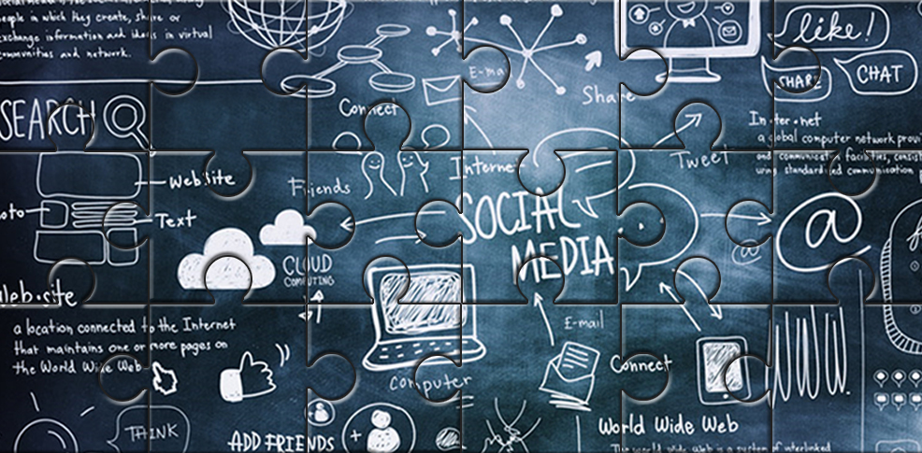
OPSEC?
NCSC.gov
OPSEC
Notes:
TRANSITION SLIDE:
PRESENTER: “We work in environments increasingly dependent on information – Information that is vital to our prosperity, competitiveness, and our security. We’ve already discussed at length the need to safeguard sensitive and proprietary information, but sometimes we need to be equally vigilant in how we protect other information that, in and of itself, may not compromise our economic or national security, but could be comparably damaging.
In today’s connected world, even small pieces of information that are seemingly harmless on their own (social media postings, work schedules, phone directories, etc.) could be assembled like a jigsaw puzzle to form the “big picture” of an organization or activity. It is very easy to overlook OPSEC.”

Slide 22

OPSEC VIDEO
Notes:
Play the video first, then get into the discussion of OPSEC.
PRESENTER: HOVER OVER THE BOTTOM FRAME. CLICK THE PLAY BUTTON TO VIEW MOVIE.
CLICK THE ENTER KEY TO GO TO NEXT SLIDE

Slide 23





Espionage
Social Engineering
Communications Intercept
Elicitation
OPSEC
OPSEC, or Operational Security, is the process of identifying, controlling and protecting sensitive and proprietary information which, if it became known to a competitor or adversary, could be used to weaken our security or competitiveness.
Notes:
PRESENTER: Click to display OPSEC definition
“OPSEC, or Operations Security, is the process of identifying, controlling, and protecting sensitive and proprietary information which, if it becomes known to a competitor or adversary, could be used to undermine our security or competitiveness.”
PRESENTER: “Practicing good OPSEC is central to the protection of sensitive and proprietary information, whether from simple, accidental disclosure or more sophisticated, targeted efforts by foreign adversaries and competitors to acquire it.
CLICK TO DISPLAY THE FOLLOWING:
They can acquire through:
CLICK social engineering,
CLICK communications intercept,
CLICK elicitation and
CLICK espionage
CLICK TO DISPLAY THE FOLLOWING:
But sometimes we inadvertently give it to them: conversations in public areas, social networking, web pages, email

Slide 24
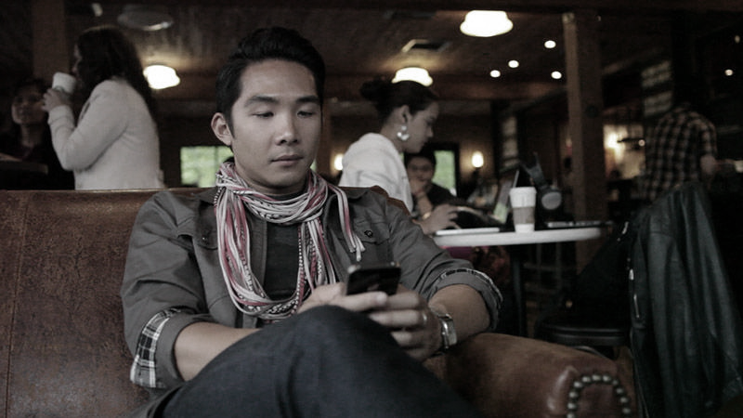
Conversations in public areas
Social networking
Web pages*
Emails
But, sometimes we inadvertently give it to them
Notes:
PRESENTER: “ But, sometimes we inadvertently give it to them through:
Conversations in public areas
Social Networking
Web pages
Email”

Slide 25

What information do you want to protect?
Who wants your information?
Is your information vulnerable?
How can you protect your information?
Employees with access to sensitive and proprietary information
Notes:
PRESENTER: CLICK to display the following:
“Employees with access to sensitive and proprietary information should ask themselves these question
What information do you want to protect?
Who wants your information?
How is your information vulnerable?
How can you protect your information?”

Slide 26
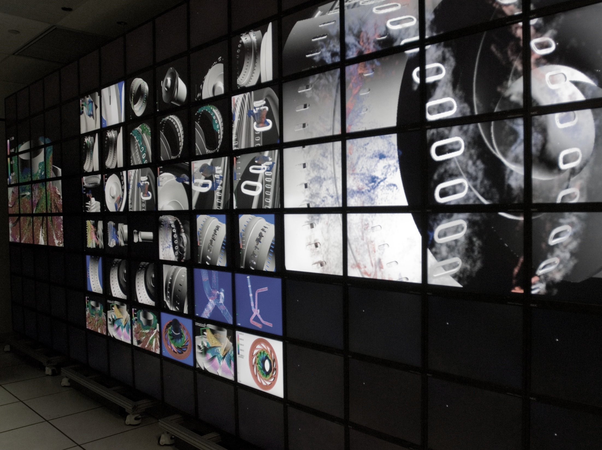
Practice good OPSEC
Things to Remember
Consider the threat when you…
1
2
3
4
Post on social media or engage in social networking
Use the phone or send email
Answer work-related questions from strangers
Discuss work in public places
Notes:
PRESENTER:
“Practicing good OPSEC means considering the threats to this information when you:
Use the phone or send email
Answer work-related questions from strangers
Discuss work in public places
Post on social media or engage in social networking”
NOTE: Though theses bullets are self explanatory, feel free to elaborate as needed.

Slide 27
ANSWERS
C
A. Discuss work in public places
D
B. Post on social media or engage in social networking
A
C. Use the phone or send email
B
D. Answer work-related questions from strangers
Things to Remember- Consider the threat when you…
SUMMARY
OPSEC
Notes:
PRESENTER:
NOTE- This is an interactive, fun, summary/recap of the module, based on the “Things to Remember” slide. See if the audience can match the correct icon and statement. CLICK the mouse to reveal each answer.

Slide 28

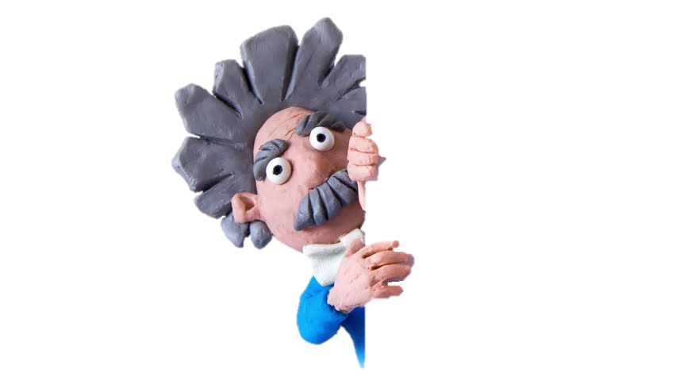
Research and Innovation
Notes:
TRANSITION SLIDE:
PRESENTER: “In the 21st century, our national and economic security interests are directly tied to the innovative efforts of those in the scientific, research, and academic communities. Numerous government departments and agencies are at the forefront of advanced research, development, experimentation, and testing that drives our groundbreaking technological, scientific, and engineering endeavors.
Foreign adversaries and competitors routinely target our research and development (R&D) activities to enhance their competitive posture by avoiding the costs and delays associated with pursuing their own R&D initiatives.”
The United States is a society of openness and freedom, and the targeted communities are well-known for their collaborative efforts and open sharing of information. Foreign adversaries and competitors have been taking advantage of this openness for years, using a variety of personnel, including scientist, engineers, businessmen, and academics, to try and collect sensitive information while visiting the United States.
As an example, several agencies accept foreign national assignees in their workforce or presence overseas. These individuals can be vital to mission accomplishment, but organizations must ensure proper vetting, considering the sensitivity and vulnerability of the information these foreign nationals might have access to.”

Slide 29

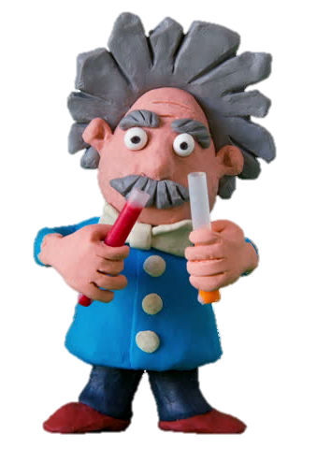
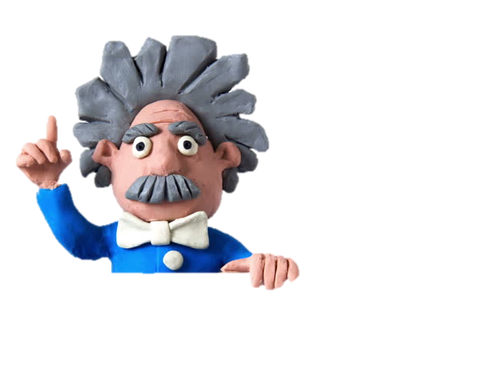
SMEs
Scientists
D E S I G N S
T
R
A
D
E
S
E
C
R
E
T
S
I
N
T
E
L
L
E
C
T
U
A
L
Researchers
Engineers
Understand the value of your information
S
E
P
Y
T
O
T
O
R
P
M E R G I N G T E C H N O L O G I E S
C
O
D
E
S
Report any contact that is suspicious
P R O P E R T Y
R
E
S
E
A
R
C
H
F O R M U L A S
What are they after?
Who will they target?
Notes:
PRESENTER: CLICK once to display the following:
PRESENTER: “Who will they target? Foreign adversaries and competitors routinely target our research and development (R&D) activities to enhance their competitive posture by avoiding the costs and delays associated with pursuing their own R&D initiatives.”
PRESENTER: CLICK once to display the following:
PRESENTER: “What are they after?
Trade secrets, emerging technologies, intellectual property, research & development, and designs, prototypes, formulas and codes
PRESENTER: “What should you do?
1- Understand the value of the information you have access to. Even though it may not be classified, it can still be highly coveted by our adversaries and competitors.
2- Report any contact, including email, telephone, or personal contact, that is suspicious because of the subject matter or the unusual nature of the contact.

Slide 30
D E S I G N S
T
R
A
D
E
S
E
C
R
E
T
S
I
N
T
E
L
L
E
C
T
U
A
L
S
E
P
Y
T
O
T
O
R
P
M E R G I N G T E C H N O L O G I E S
C
O
D
E
S
P R O P E R T Y
R
E
S
E
A
R
C
H
F O R M U L A S
SUMMARY
Research and Innovation
Notes:
PRESENTER:
NOTE- This is an interactive, fun, summary/recap of the module. See if the audience can remember what are foreign adversaries seek from the U.S. CLICK once to reveal the answer, until complete.
Trade Secrets, Emerging Technologies, Intellectual Property, Research, Prototypes, Designs, Formulas, Codes

Slide 31
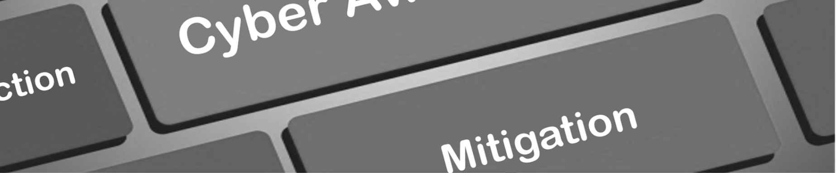




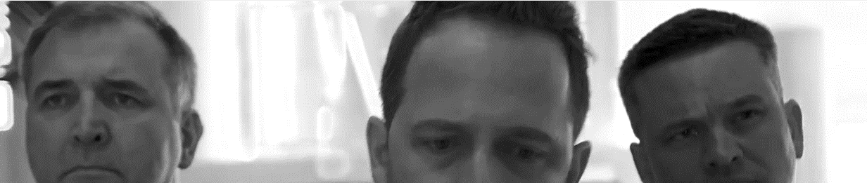
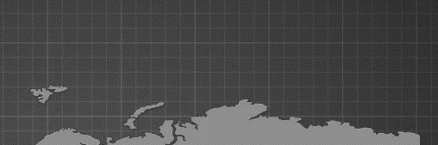
Summary
CFIT
CFIT
CFIT
BE AWARE
Our foreign adversaries and competitors are no longer targeting just classified information and the national security community. They are targeting any sensitive information, infrastructure, technology, or other resources that would weaken our economic and national security and strengthen their own.
The responsibility to counter foreign intelligence threats is one that is shared across the executive branch, private industry, and other organizations – YOU play an essential role.
We hope this presentation helped you recognize foreign intelligence approaches, the entities and individuals they are targeting, and why sensitive information and resources, essential to America’s security and global competitiveness, must be protected.
REPORT
Notes:
NOTE- This is the conclusion of class. This is a Summary slide.

